Slide 1
Full-Stack Web Development Lecture 9: Making it pretty Ashley Williams Ashley.Williams@mmu.ac.uk

Slide 2
Learning Objectives
To understand:
The what, why and how’s of style, style guides, and style libraries
How to build scalable component-based front-end applications

Slide 3
Unit Overview
# | W/C | Lecture | Lab
1 | 03/10/2022 | Introduction to Full-Stack | Recap/RESTful APIs
2 | 10/10/2022 | Introduction to NodeJS/ExpressJS | Getting started with NodeJS/ExpressJS
3 | 17/10/2022 | Interacting with Databases | Interacting with Databases
4 | 24/10/2022 | Handling Authentication | Handling Authentication
5 | 31/10/2022 | Version Control | Assignment Support: Backend
6 | 07/11/2022 | API Security and Scaling | Assignment Support: Backend
7 | 14/11/2022 | Introduction to VueJS | VueJS Basics
8 | 21/11/2022 | Networking | Handling API requests
9 | 28/11/2022 | Style, Layout, and Navigation | Layout and Navigation
10 | 05/12/2022 | Code Quality, Structuring and Refactoring | Assignment Support: Front-end
11 | 12/12/2022 | Everything Else! | Assignment Support: Front-end

Slide 4
Where are we up to?
Back end application is complete
Front end:
We have a authentication system implemented
We have all of the non-authenticated endpoints implemented
But it’s ugly…
Assignment: functionality 75%; style 15%; extensions 10%

Slide 5
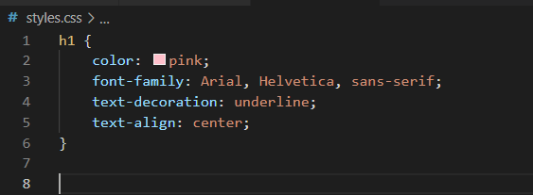
Recap last year
For adding style, we use cascading style sheets (CSS)
CSS rules consist of a selector (h1) and then an object of key-value style rules
Key: CSS property
What’s the difference between ID’s and classes in CSS?

Slide 6
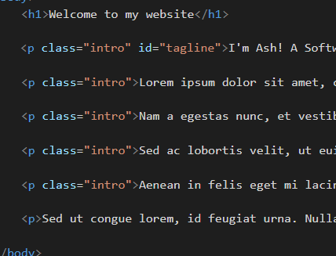
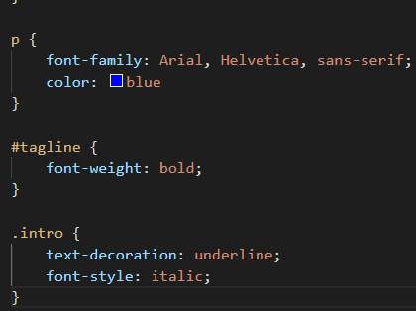

Recap last year
ID: identifies a single element on the page to style
Class: identifies a group of elements on the page. A class style will apply to them all
An element may have both, and may have multiple classes

Slide 7
Brand Style Guides
Not to be confused with code style guides
A published set of guidelines for how to project the brand (e.g., logo use, typography, layout and spacing)
Created by the UX designers:
Maintain brand consistency (more professional/recognisable)
A single reference source to communicate
Clear guidance for developers (especially new developers)
More efficient graphic design
Standardising CSS, JS, HTML and kept DRY (Don’t Repeat Yourself)
Aid decision making
Increase customer brand recognition

Slide 8
Brand Style Guides
Brand style guides typically contain:
Guide for logo use
Colour schemes
Image and icon usage
Typography
Components like buttons and forms
Grid system and spacing
Template designs
Guidelines for other platforms
Voice (how to talk, tone, brand identity)
Mission, purpose and values
Other stuff…
https://uxhacks.com/website-style-guide/

Slide 9
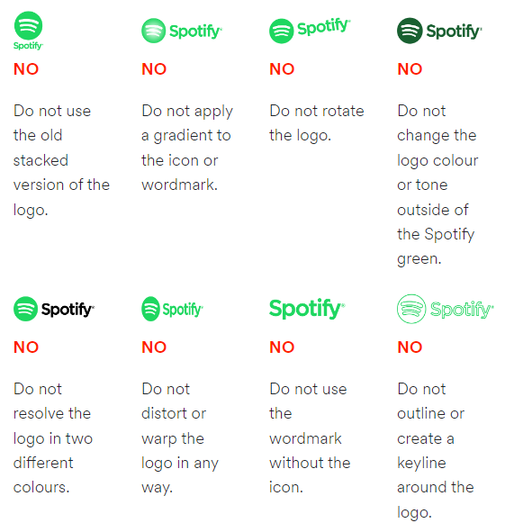
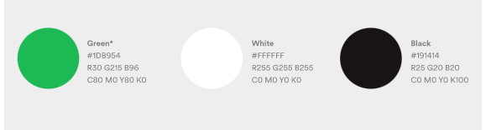
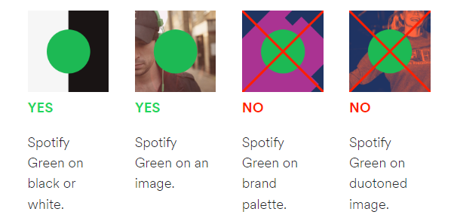
Brand Style Guides: Spotify
https://developer.spotify.com/documentation/general/design-and-branding/#using-our-logo

Slide 10
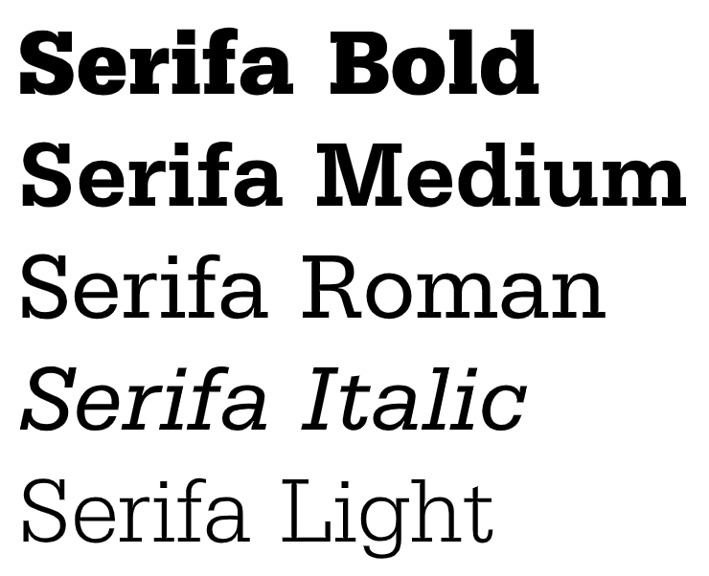
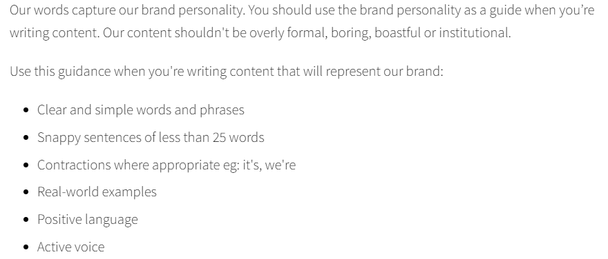
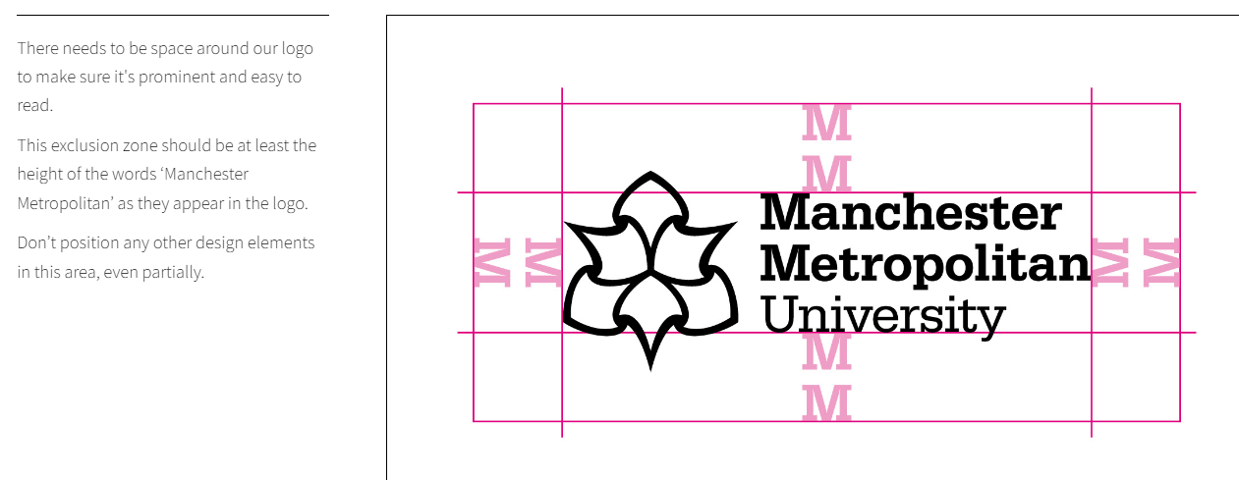
Brand Style Guides: MMU
https://www.mmu.ac.uk/brand/introduction/

Slide 11
Brand Style Guides
UX team designs the brand style guides, then the developers create stylesheets and assets that follow such guidelines
Most companies you go into will already have such assets in place for you to use from day one
However, in your own projects you will need to create from scratch.
There are existing frameworks in place to help you…

Slide 12
Style Frameworks

Slide 13
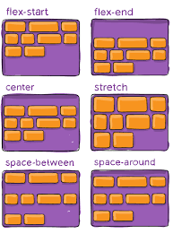
CSS layout frameworks (recap)
Rather than code everything from scratch, CSS includes some handy frameworks for building UI’s
Flexbox is one such framework
Flexbox allows you to dynamically allocate space in the viewport
You give each of your elements a flex number, the numbers are summed and the screen is divided by the total number, allocating the given proportions for each component
https://flexboxfroggy.com

Slide 14


Bootstrap
“Bootstrap is a free and open-source CSS framework directed at responsive, mobile-first front-end web development. It contains HTML, CSS and JavaScript-based design templates for typography, forms, buttons, navigation, and other interface components.”
Initially released: August 2011
Created by: Twitter

Slide 15
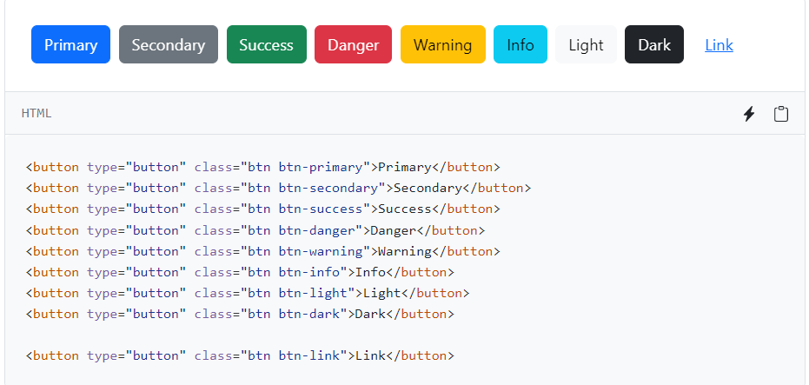
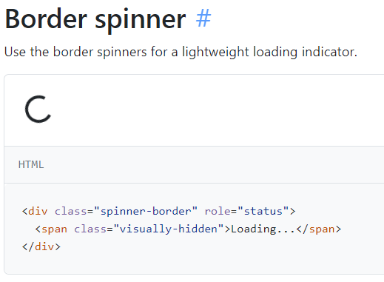
Bootstrap
Essentially a group of pre-built components
Simply install bootstrap, and then use the relevant classes in your code
Layout, buttons, forms, accordion, navigation bars, anything…
Really great documentation to help: https://getbootstrap.com/docs/5.2/components/buttons/

Slide 16
Loads of tutorials!
Getting started (~30mins): https://www.youtube.com/watch?v=Vu5QKn24uYs
BootstrapVue: a library for making bootstrap/vue integration as simple as possible: https://bootstrap-vue.org/

Slide 17

Tailwind
“Tailwind CSS is an open source CSS framework. The main feature of this library is that, unlike other CSS frameworks like Bootstrap, it does not provide a series of predefined classes for elements such as buttons or tables.”
Essentially a group of classes for creating your own components
Much more flexibility
Best demo is the animations on the homepage: https://tailwindcss.com/

Slide 18
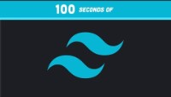
Tailwind in 100 seconds
Notes:
https://www.youtube.com/watch?v=mr15Xzb1Ook&ab_channel=Fireship

Slide 19
Loads of tutorials!
Setting up (~6mins): https://www.youtube.com/watch?v=i6vQrVOoAJc
Create a Pokemon app in Vue with Tailwind (~30mins): https://www.youtube.com/watch?v=QJhqr7jqxVo

Slide 20
Which one is best?
It depends…
Bootstrap sites look the same, but pre-built components means much faster prototyping
…though a dev who is really good with Tailwind might disagree
Which will you use for your assignment?
Bootstrap | Tailwind
Pre-build components means super-fast prototyping | Utility classes allows the develop to create a neat UI with more flexibility and uniqueness
Every bootstrap site looks the same/generic | Requires a lot of code, leading to a cluttered HTML
Used by big names: Spotify, Twitter, Lyft | Small (274kb)

Slide 21
Scaling Component-Based Interfaces

Slide 22
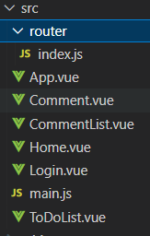
Structuring applications
Last week, I briefly mentioned structuring applications
Having all components in a single directory gets messy quickly:
Comment is for displaying a single comment component
Home and View are entire pages

Slide 23
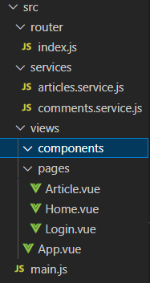
Structuring applications
How I code Vue apps:
Directory for router and services
Views has two sub-directories:
Components: for helper components (e.g., Comment, CommentList)
Pages: for entire pages (e.g., Home, Login, Article)
Ultimately, you have the freedom to structure your application however you want
Often depends on context, requirements, resources, company guidelines
However, there are existing structures to help you

Slide 24
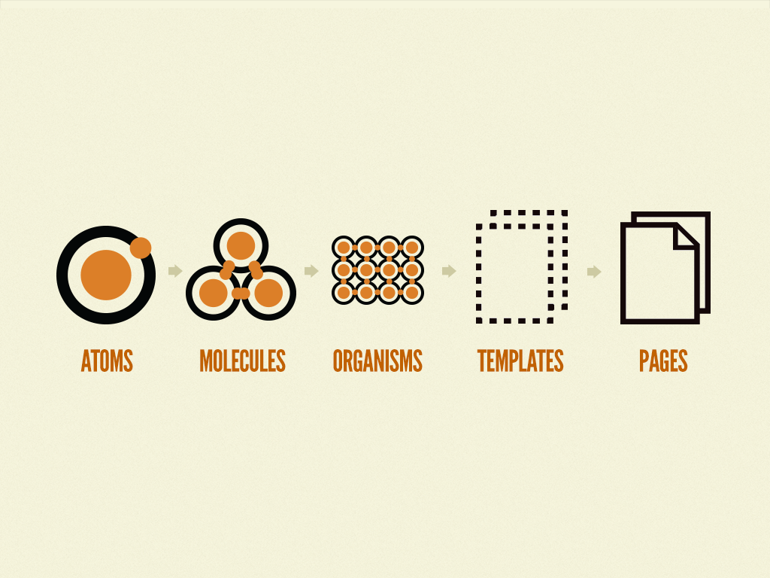
Atomic Design Structure
For larger applications, or a more scalable structure, one option is to use atomic design.
Atomic design breaks down UI elements into a hierarchy of atoms, molecules, organisms, templates and pages
Let’s take a brief look at what this means…
Source: https://cheesecakelabs.com/blog/efficient-way-structure-react-native-projects/

Slide 25
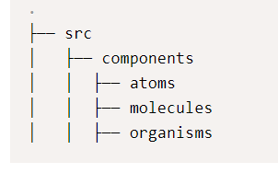
Atomic Design Structure: Elements
Atoms: The smallest possible components, such as buttons, titles, inputs or event colour pallets, animations and fonts.
Molecules: They are the composition of one or more components of atoms.
Organisms: The combination of molecules that work together or even with atoms that compose more elaborate interfaces
Can also add a navigations directory
Can also add a services directory (api)
Can also add a styles directory
Can also add a utils directory (helper methods)

Slide 26
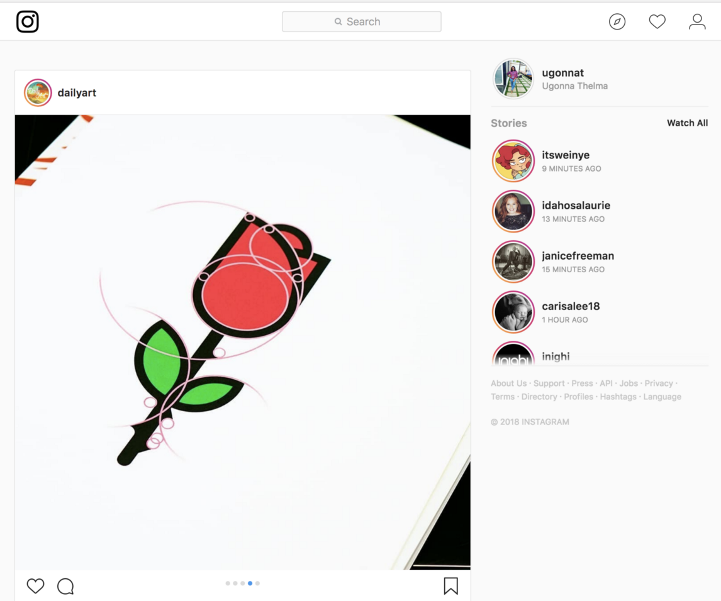
Atomic Design Structure - Example
Breaking down Instagram – top down
Source: https://medium.com/backticks-tildes/visually-breaking-down-ui-components-using-atomic-design-part-1-476e1ddd73ca

Slide 27
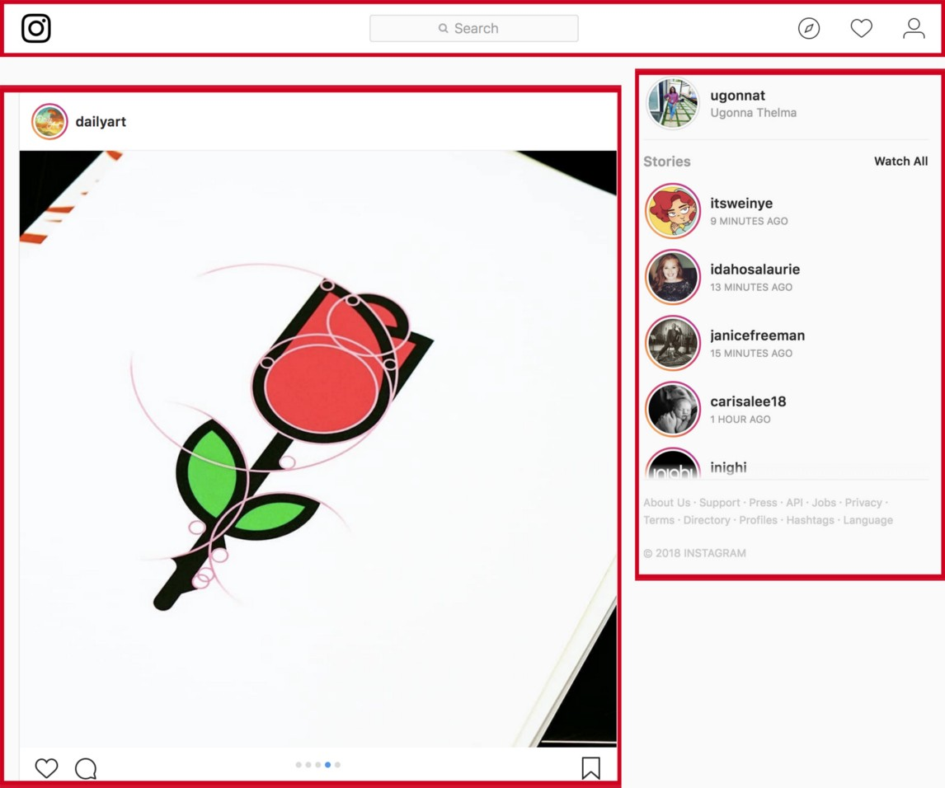
Atomic Design Structure – Identify organisms

Slide 28
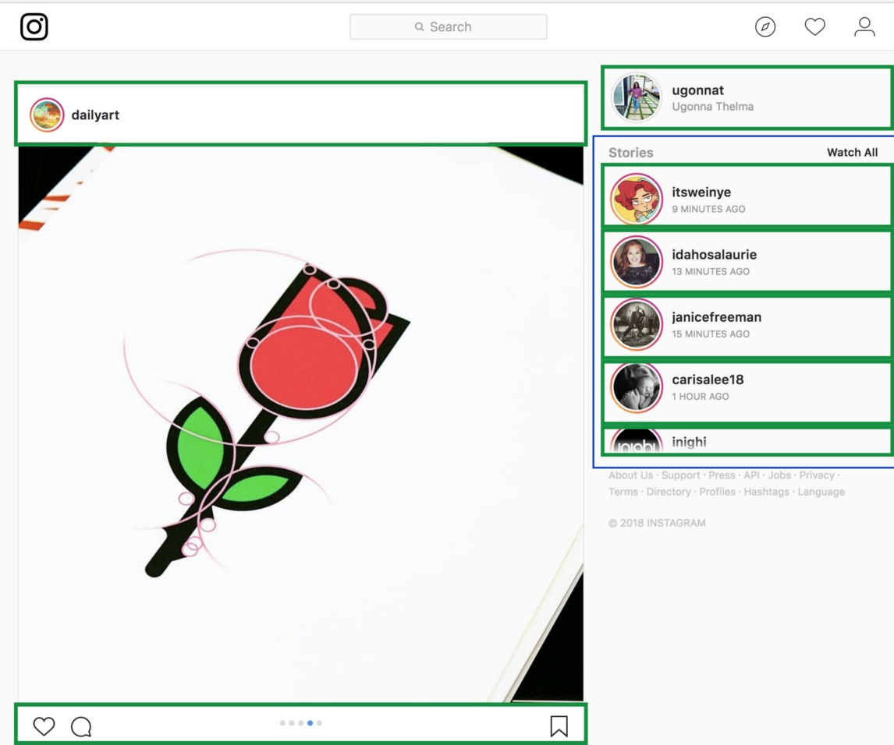
Atomic Design Structure – Identify molecules

Slide 29
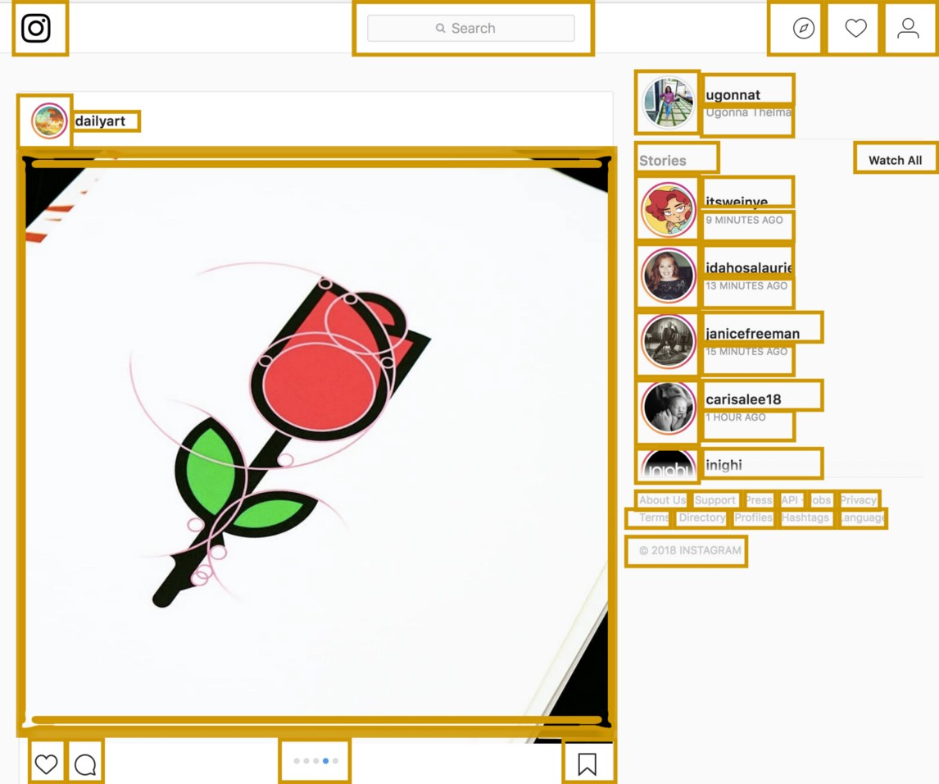
Atomic Design Structure – Identify atoms

Slide 30
Atomic Design Structure
Perhaps overkill for your assignment – or maybe not…
Scalable code makes your life easier in the long run
Focusing on atoms means that your molecules and organisms become a sort of plug and play
Another string to your bow when it comes to showing off your assignment as a portfolio piece

Slide 31
Technical Debt
The cost of additional rework caused by choosing an easy solution now instead of using a better approach that would take longer
Accumulates “interest”: the longer you leave it, the more difficult it is to change.
Interest is not always a bad thing (e.g. proof of concept/prototyping)

Slide 32
Technical Debt – Common Causes
Ongoing development over time leaves old solutions sub-optimal
Sub-optimal requirements definitions upfront
Lack of process or understanding
Lack of test suite
Lack of documentation
Parallel development on multiple branches accumulates technical debt because of the work required to merge
Delayed Refactoring
Lack of collaboration/proper mentoring of junior developers
Source: https://en.wikipedia.org/wiki/Technical_debt

Slide 33
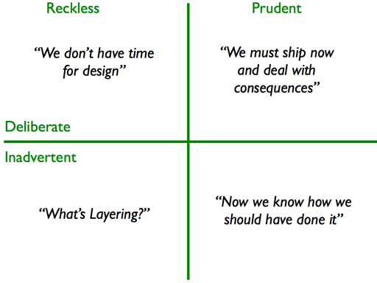
Technical Debt – TD Quadrant
Source: https://martinfowler.com/bliki/TechnicalDebtQuadrant.html
…so, we want to minimise technical debt and avoid code smells
Next week!

Slide 34
This week’s lab
Make it pretty…

Slide 35
Questions?

